Slide 1
Easy selection of patient monitor
Group 9
Veena Ravi
Nivishree P
Gopinath Shanmugam
C++ Case study Evaluation 02/08/2019

Slide 2
Contents
Problem Statement
Solution Design
Design Requirements
Class Relationship
Unit Test Cases
Implementation

Slide 3
Problem statement
Developing a console based chatbot for suggesting a patient monitor to the user from the list of available patient monitors in Philips.
Make the Chatbot as a console application. The Chatbot will accept input and give its response on the console.
The conversation (sequence of messages) should lead the customer to a purchase-suggestion.
It must be easy to re-use this Chatbot for another domain (such as without having to re-compile it.

Slide 4
Solution Design
The chatbot will display MCQ questions one by one with options for the user to select. The user should select an option for each question only from the given options
The first question is default. The subsequent question is selected depending on the user’s selected input for the first question and the other questions are selected the same way
When there are no more questions to ask for finalizing a product, the chatbot will display the name(s) of the relevant patient monitors for the user

Slide 5
Chatbot Interaction Workflow [example]
MCQ 1
MCQ 2
Patient monitor 1
Patient monitor 2
MCQ 2
Patient monitor 3

Slide 6
Design Requirements
List of questions with question IDs
List of product names with their IDs
List of options with option IDs for question IDs along with the next question ID.
The above data should be stored in such a way that the chatbot algorithm could be reused by editing the database

Slide 7
Database
Sql Server Management Studio (SSMS)
3 tables were created:
Table 1: List of questions
Table 2: List of options
Table 3: List of patient monitors

Slide 8
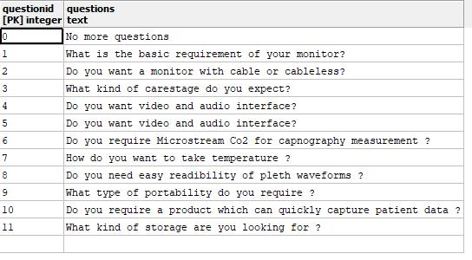
Table 1: List of questions

Slide 9
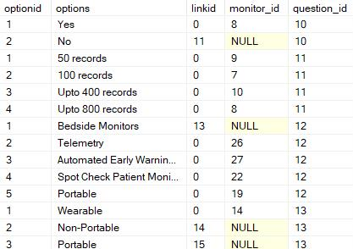
Table 2: List of options

Slide 10
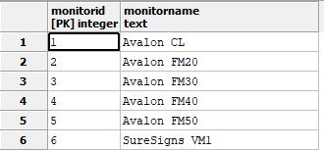
Table 3: List of patient monitors

Slide 11
Class relationship
Database
DataFetch
Chatbot
Linker

Slide 12
Unit test cases
TC ID | Method tested | No. Of test cases | Description | P/F
1 | TestNumberOfOptionsForAquestion() | 4 | For a particular question it will display all the related options | P
2 | TestIfCorrectQuestionForGivenQuestionid_1 | 2 | Given a question id it will display the question. | P
3 | TestForMonitorNameGivenMonitorid_1 | 3 | Given a monitor id it will display its corresponding monitor name | P
4 | TestIfCorrectLinkedOuestionFetchedGivenOptionAndQuestionID_1 | 2 | Given a questioned and option id corresponding linked question is given | P

Slide 13
Implementation

Slide 14
Thanks!

